Slide 1
International Business and Financial Service Centers and Tax Receipts in OECD States
Julie-Ann Burke, Sefani Busby-Thornhill and Winston Moore
Department of Economics
University of the West Indies
Cave Hill Campus
winston.moore@cavehill.uwi.edu

Slide 2
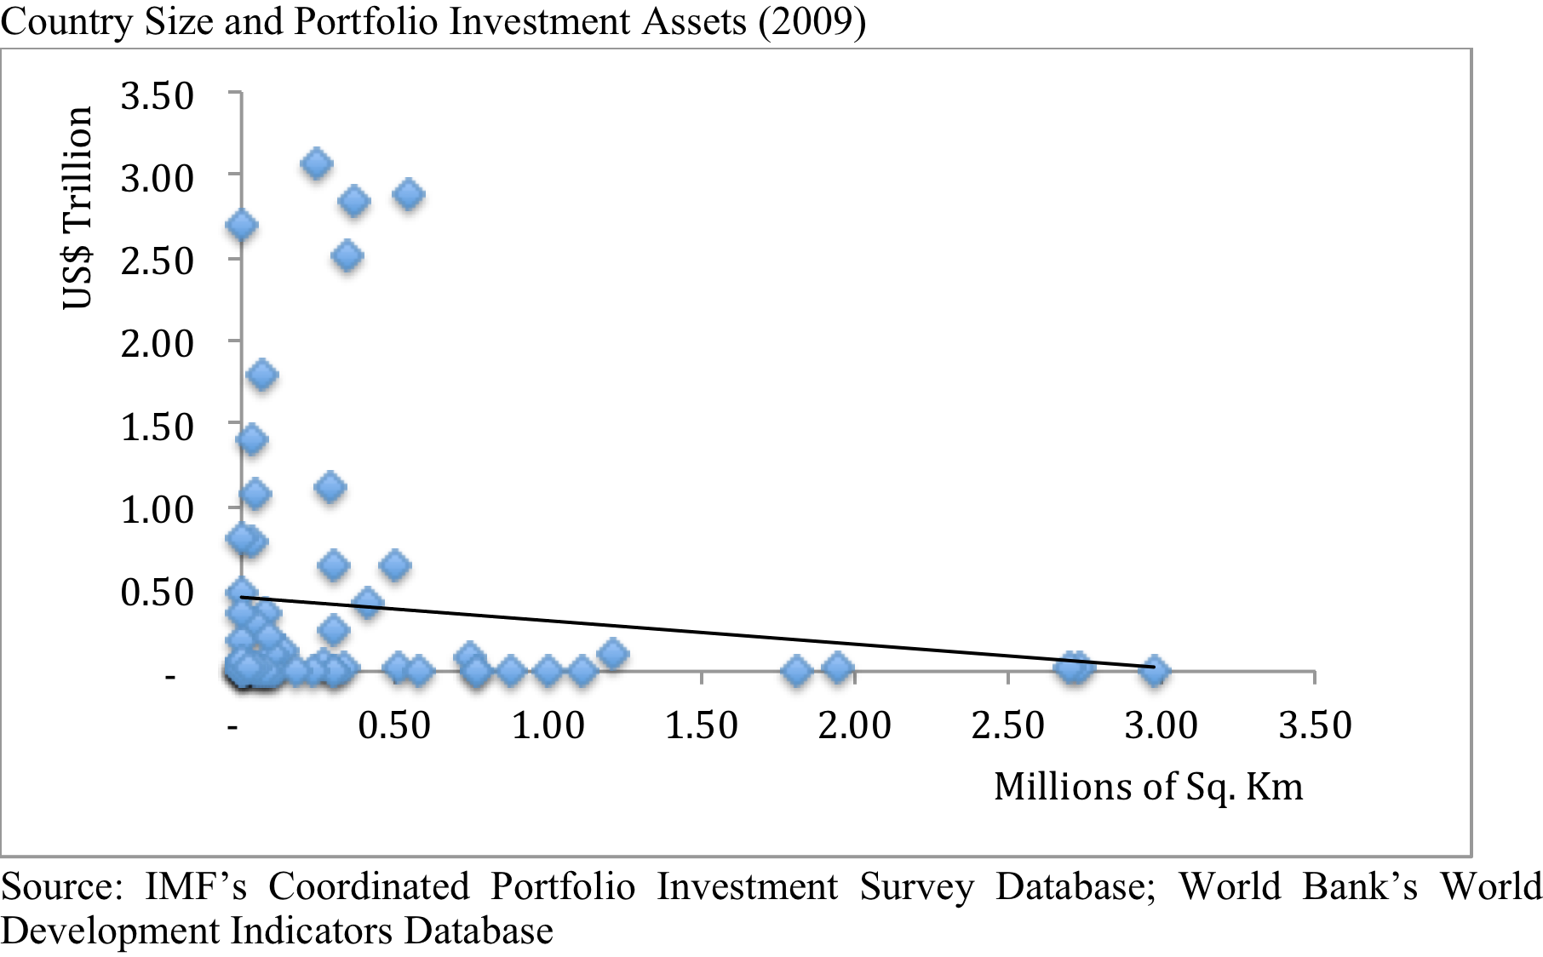
Many small states attract foreign investment funds through favorable tax rate regimes…

Slide 3
The Largest of these are…

Slide 4
These countries, however, represent a small share of global portfolio flows…

Slide 5
Despite their size, OECD (1998) report noted…
Harmful tax competition
Lack of transparency
Non-existence of information exchanges

Slide 6
Much of the academic literature has also taken the negative impact of IBFSCs as a given…
Tax evasion
Money laundering
Degradation of regulation
Flight of capital
Instability and economic underdevelopment
Overall negative effect on global welfare

Slide 7
These countries, however, represent a small share of global portfolio flows…

Slide 8
This paper attempts to…
Assess the extent to which IBFSCs have negatively affected tax receipts in OECD countries
Conceptual framework of how IBFSCs can benefit the global economy
Statistical assessment of the potential impact of IBFSCs on OECD tax receipts

Slide 9
Conceptual Framework
Types of FDI Flows
Market
Resource
Rationalization
Strategic asset
Notes:
Dunning (1993) notes that these activities can be classified into four main types: (1) market seeking, investment aimed at meeting the demand needs of a particular market; (2) resource seeking, investment directed at gaining access to a particular natural resource; (3) rationalised seeking, aimed at supporting specialisation; and, (4) strategic asset seeking, investment targeted at exploiting some specific advantage.

Slide 10
Conceptual Framework
Ownership
Internationalization
Location
Notes:
IBFSC can increase overall firm profitability and therefore lead to increased investment at home and abroad.

Slide 11
Methodology
Panel fixed effects model
Dependent variable: corporate tax receipts
Explanatory variable: indicator of IBFSC activity
Control variables
Sophistication of tax system
Corruption
Non-linearity
Difference between personal and corporate tax rates
Tax burden
Government stability
Level of per-capita Income

Slide 12
Data
Database includes
29 OECD states
2001 to 2009
Sources
OECD National Accounts and tax databases
IMF’s Coordinated Portfolio Investment Survey

Slide 13
IBFSC Indicator
Lists of tax havens derived by
Dharmapala and Hines (2009), “DH”
OECD (1998), “OECD”
Hines (2005), “HS”
Dyreng and Lindsey (2009), “DL”
Ratio of total portfolio investment assets relative to world GDP
Also calculated using portfolio investments in equity and debt securities

Slide 14
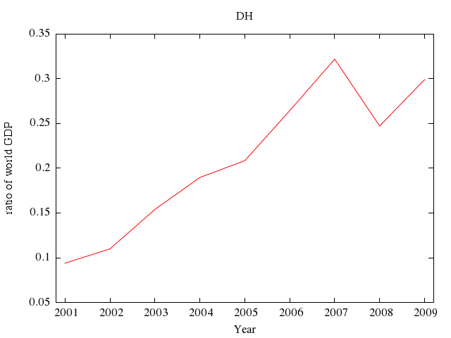
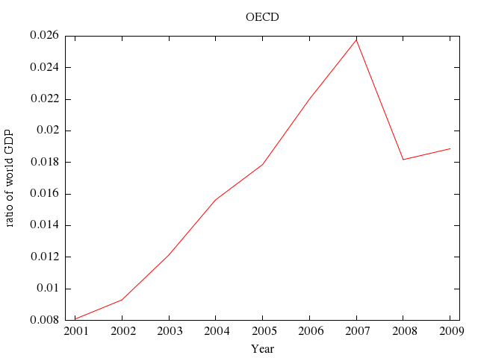
IBFSC Indicator

Slide 15
Model Specification
LM tests suggests that random effects rather than fixed effects is the preferred specification
Model is able to explain more than 30% of of the variation in corporate tax receipts in OECD states

Slide 16
Model Results

Slide 17
Findings are robust to various tests of model specification…
Endogeneity
Definition of IBFSC indicator
Ignoring model dynamics

Slide 18
Dynamic model specification results…

Slide 19
Conclusions
IBFSCs have been linked to tax avoidance and the loss of tax revenue in OECD states.
These countries, however, only represent a small portion of total portfolio flows.

Slide 20
Conclusions
This paper presents a conceptual framework where IBFSC activity can lead to a rise in firm profitability an greater investment in the home and foreign market.
Empirical evidence is found to support this framework.

